Slide 1
Data Leaks’ Online Travel Club
Members:
Jason Novio
Victor Vasconcelos
Brandon Dam
Jonah Ball
Vithujanan Vigneswaran
Notes:
Victor

Slide 2
Problem Definition
Travelling has multiple needs (flight & hotel booking, fulfilling entry requirements, networking with other travelers, etc.)
Most sites focus on only 1-2 requirements travelers need
Notes:
victor

Slide 3
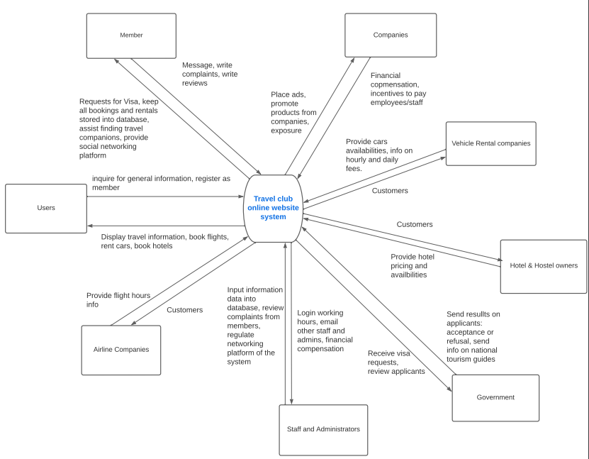
Proposed Solution
New website implementing all services in a single place
Notes:
victor

Slide 4
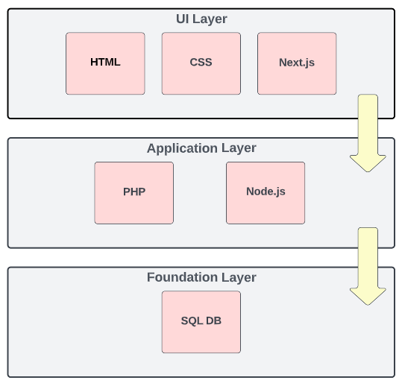
System Architecture
Multi-layered Architecture consisting of:
UI (HTML, CSS, React, Next.js)
Application Layer (PHP, Node.js)
Foundation Layer (MySQL, JSON)
Notes:
Jonah

Slide 5
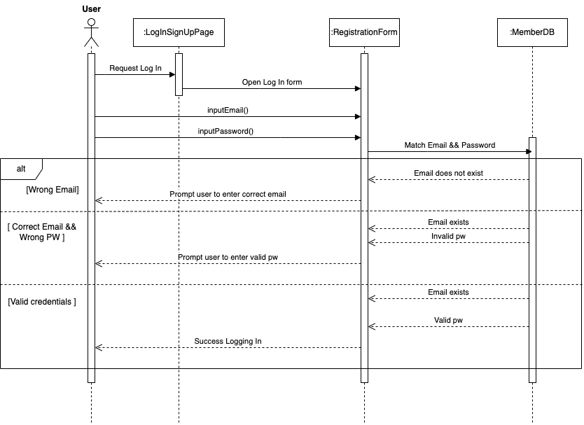
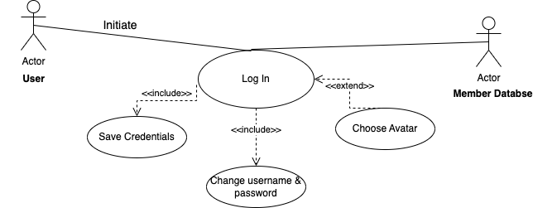
Request Center Use Case and Sequence Diagrams
Notes:
Vithu

Slide 6
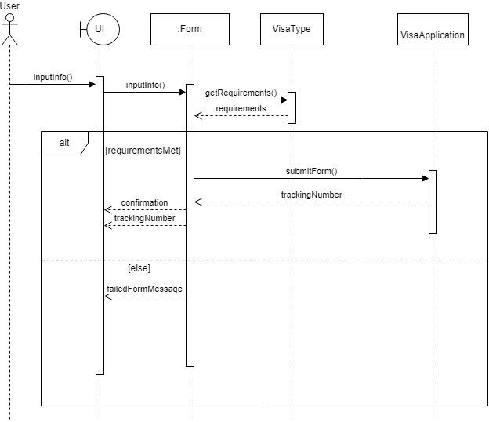
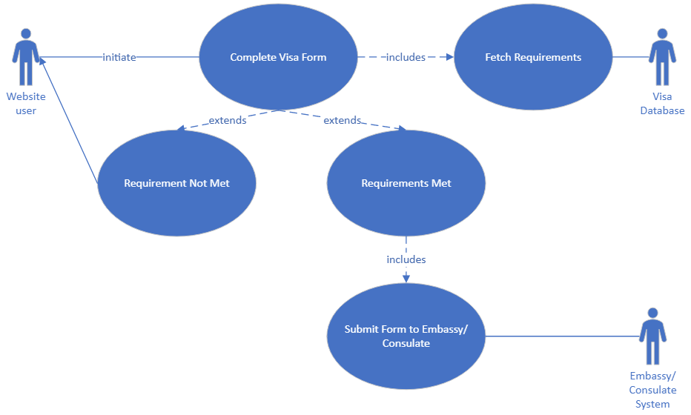
Visa Portal Use Case and Sequence Diagrams
Notes:
Victor

Slide 7
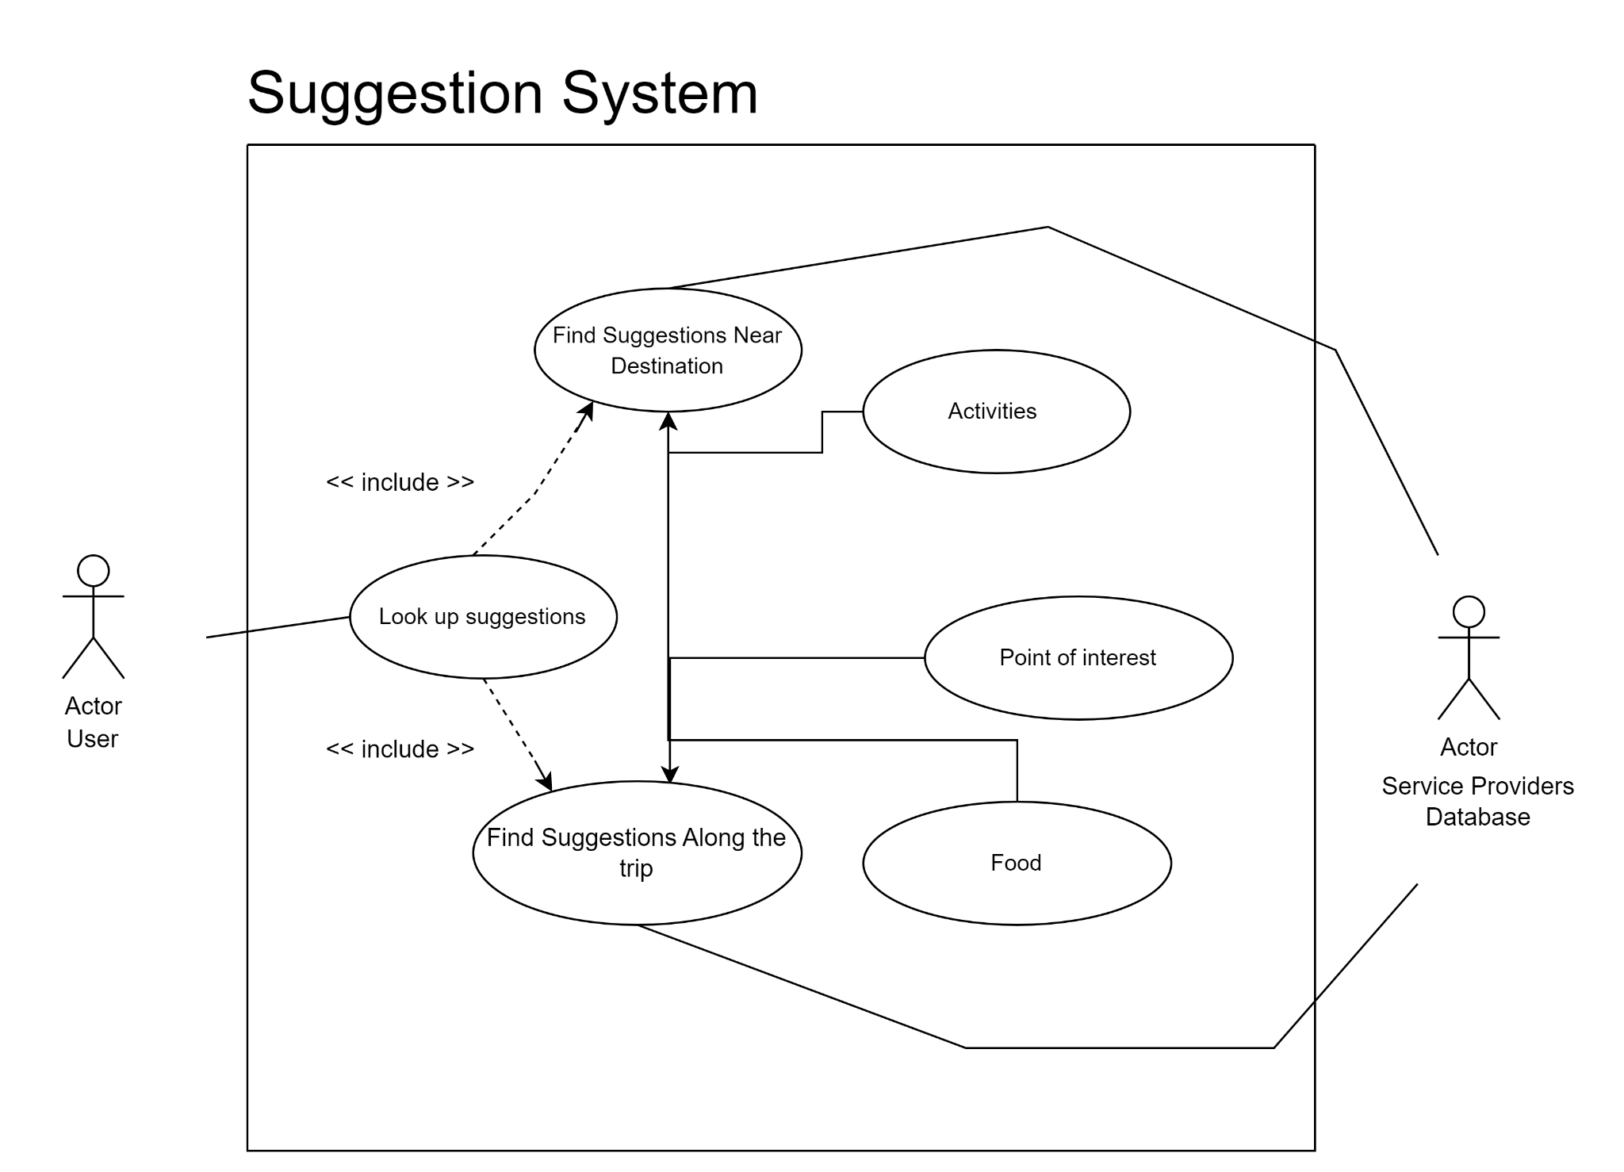
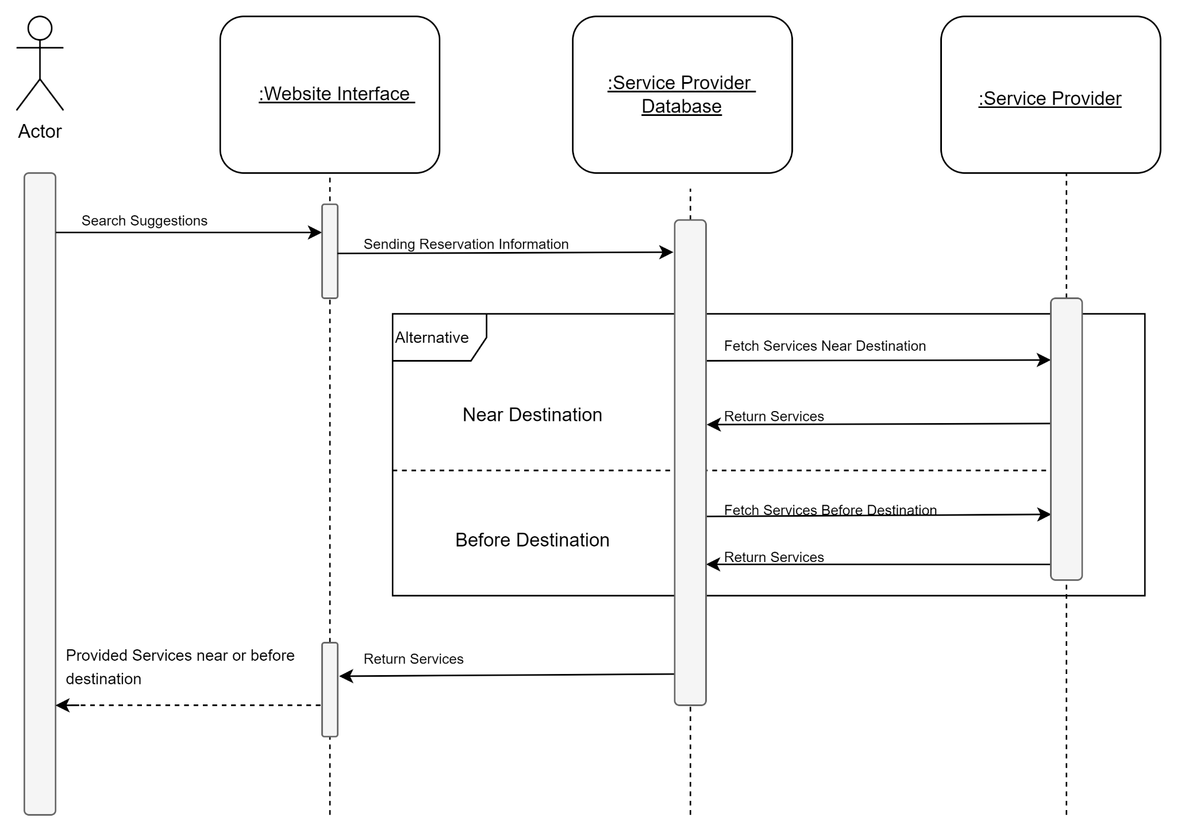
Reservation Portal Use Case and Sequence Diagrams
Notes:
Jason

Slide 8
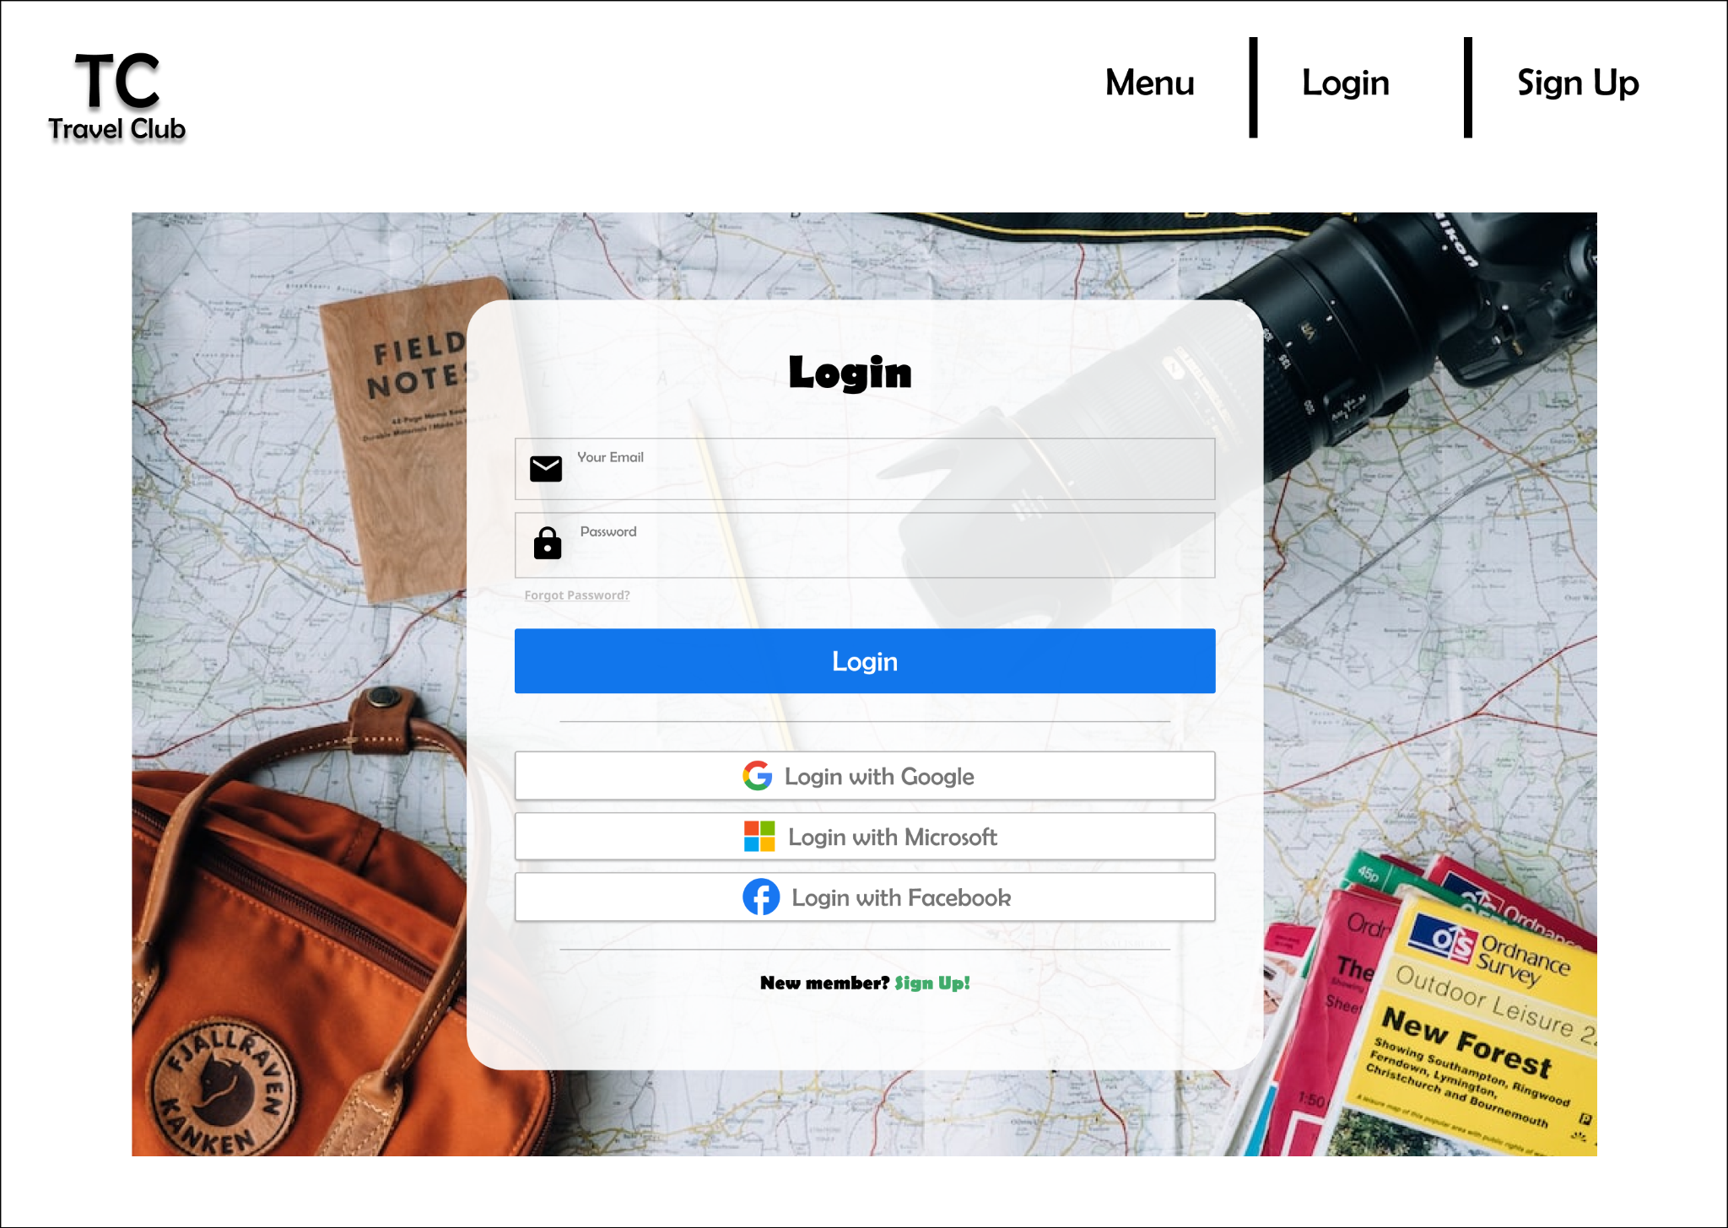
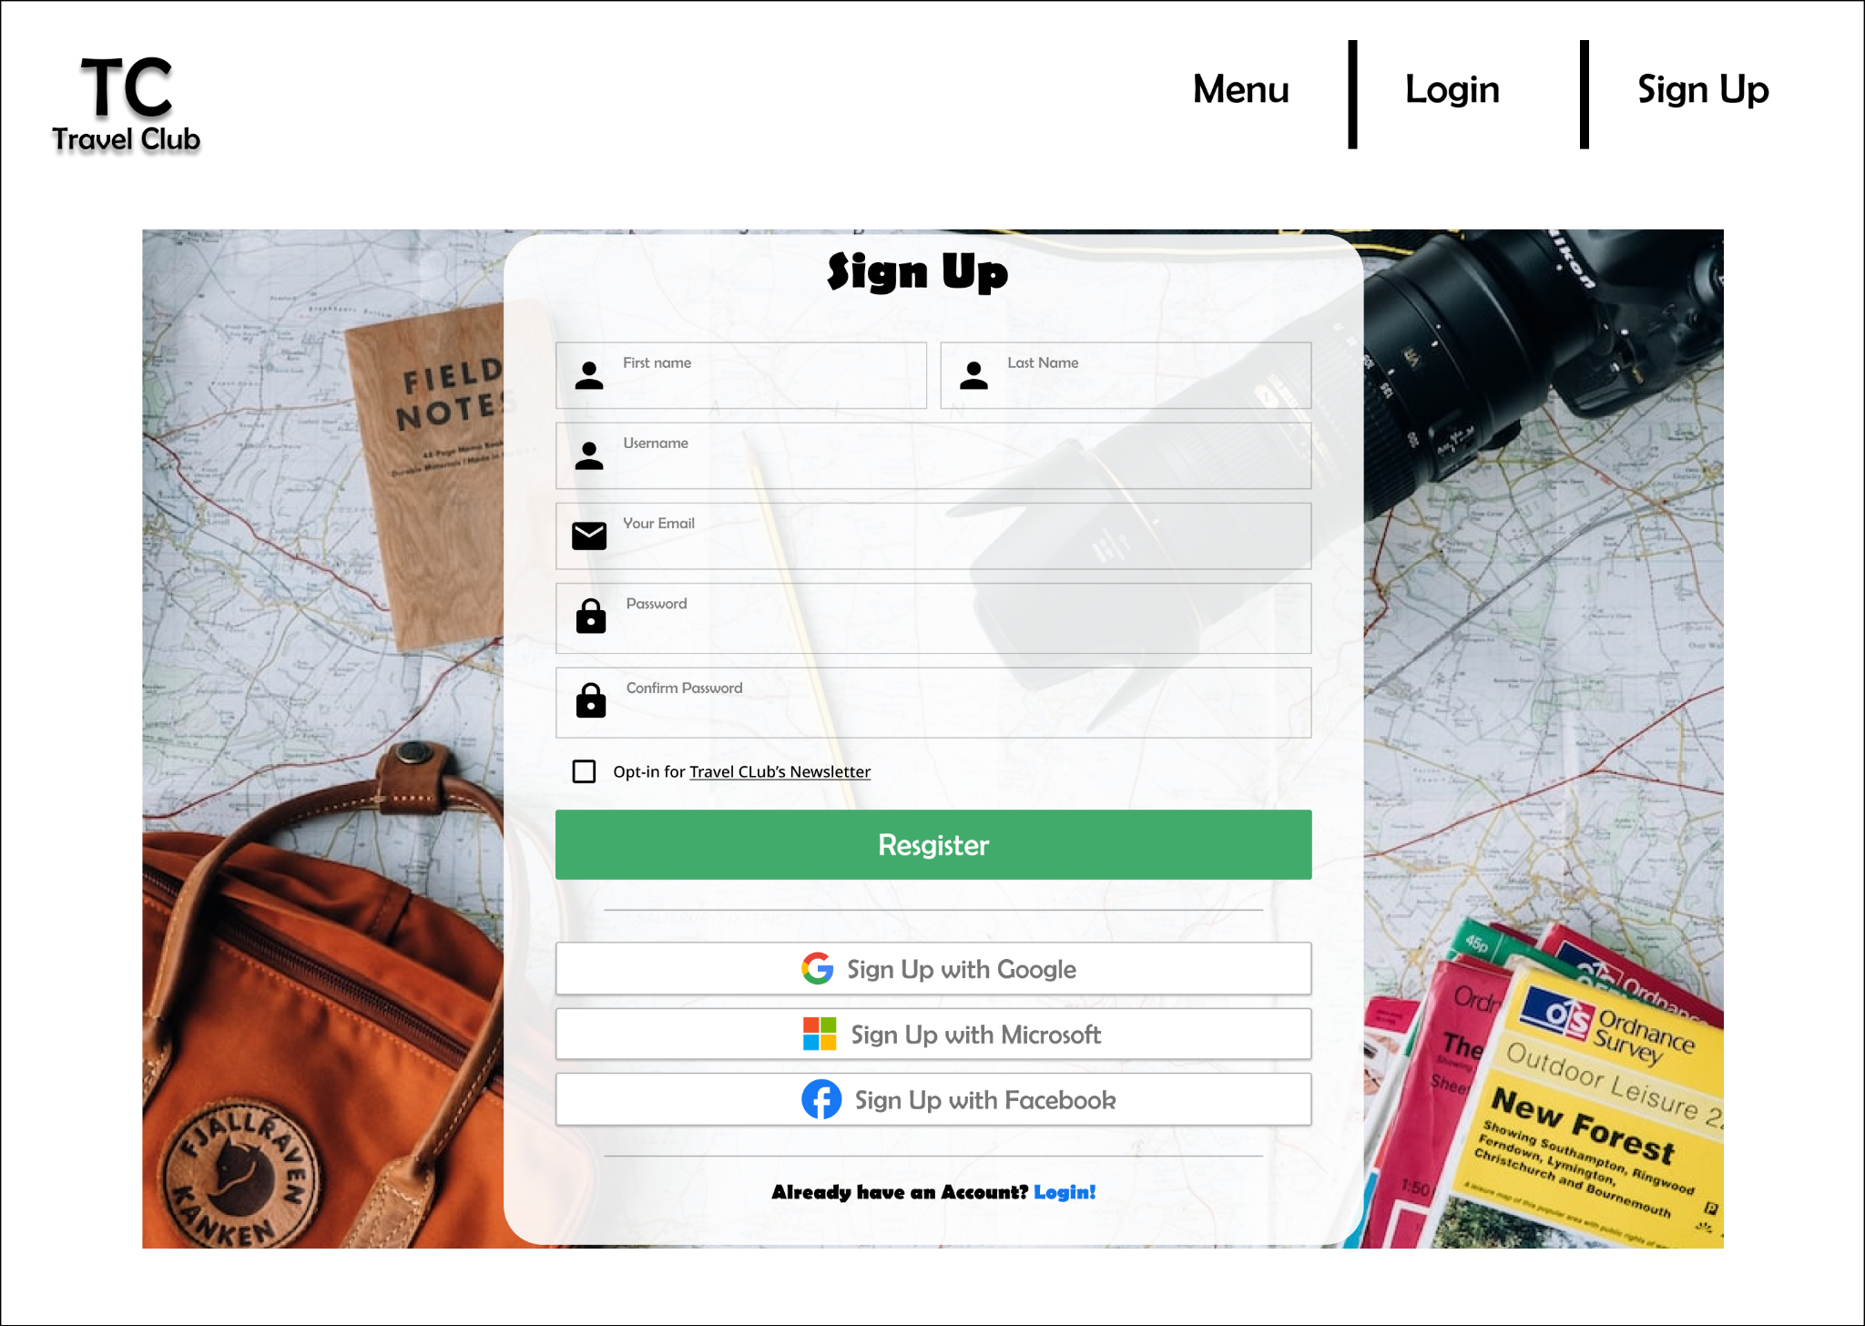
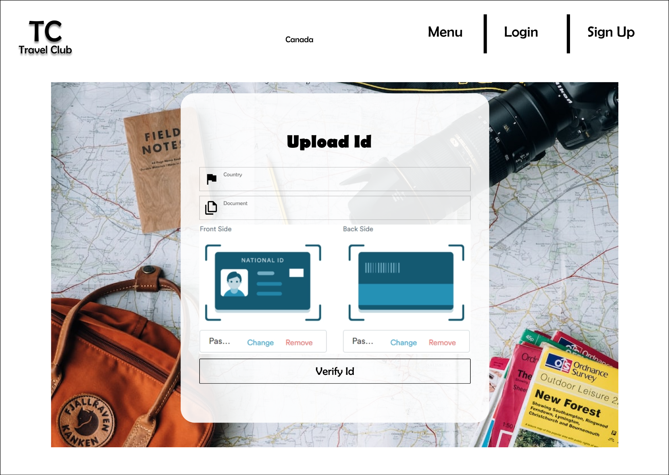
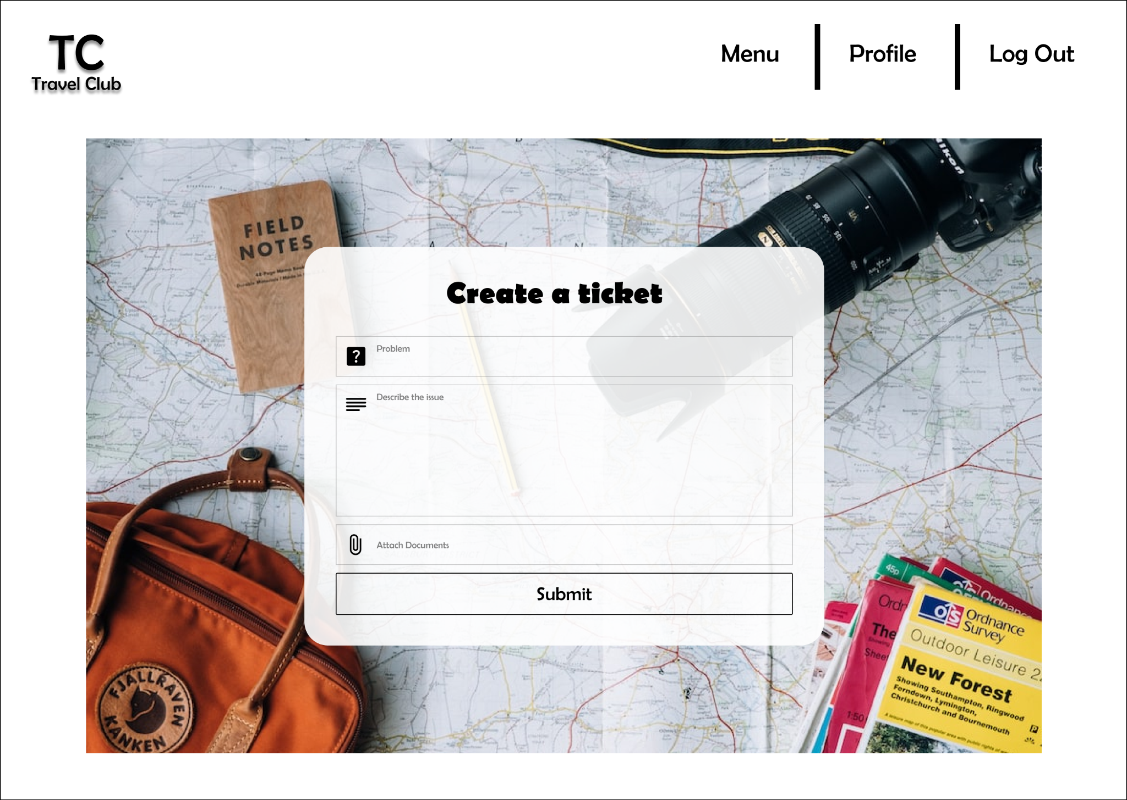
Request Center UI
Notes:
Brandon

Slide 9
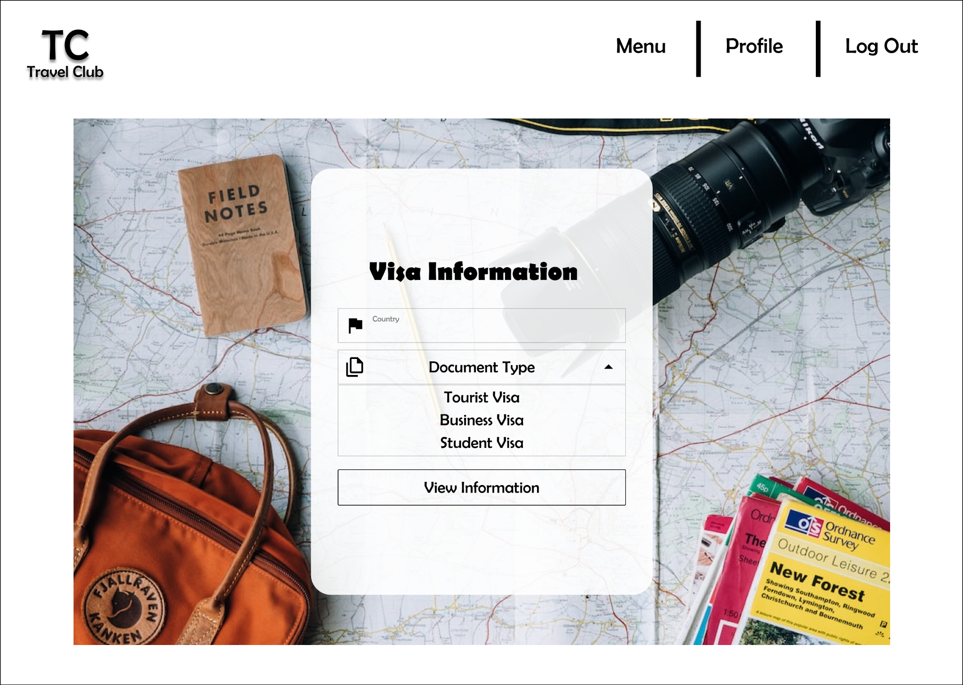
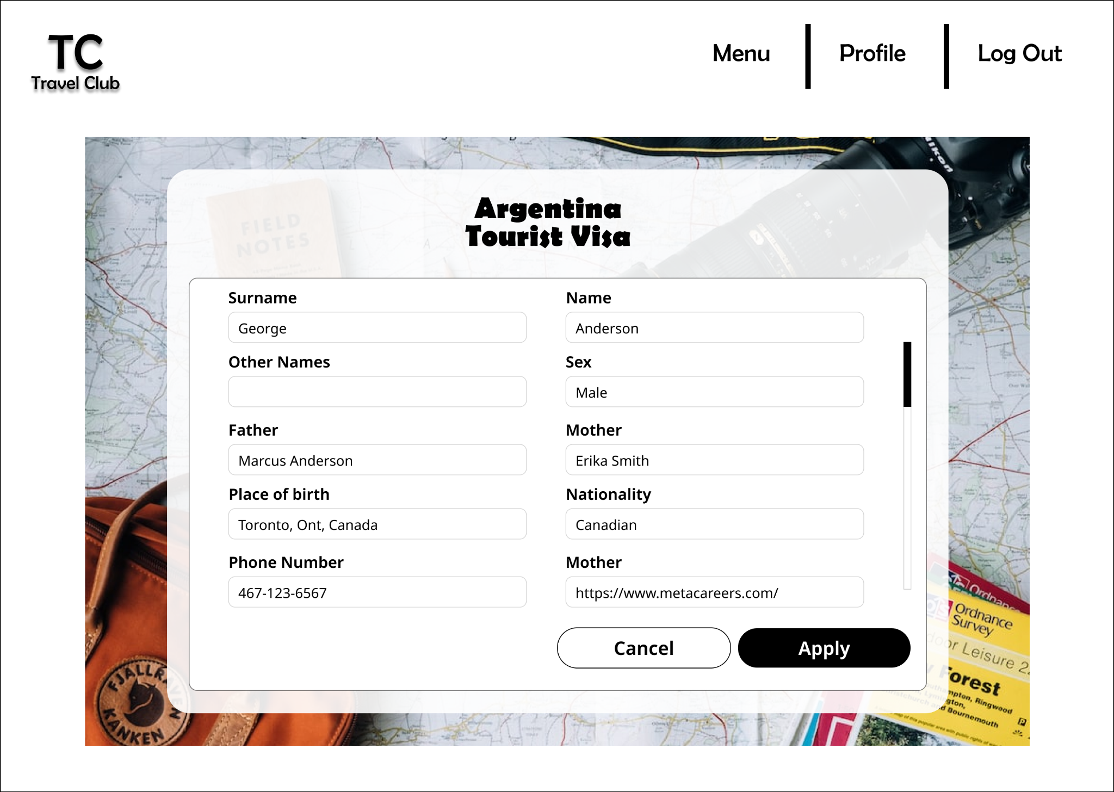
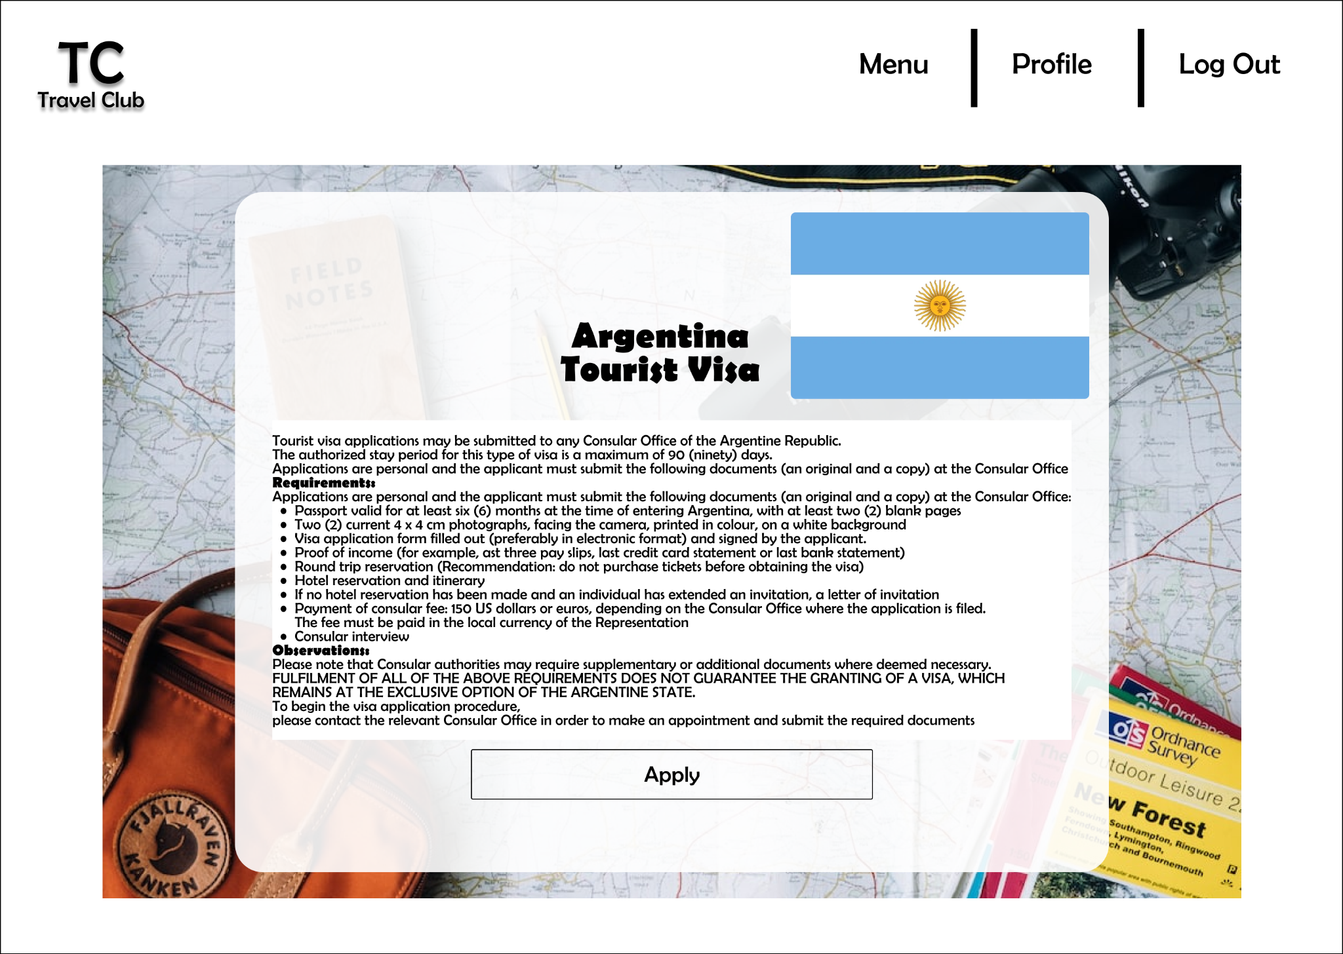
Visa Portal UI
Viewing a Selected Country’s Visa Information
Selecting Visa Information to view
Filling application for visa request
Notes:
Brandon

Slide 10
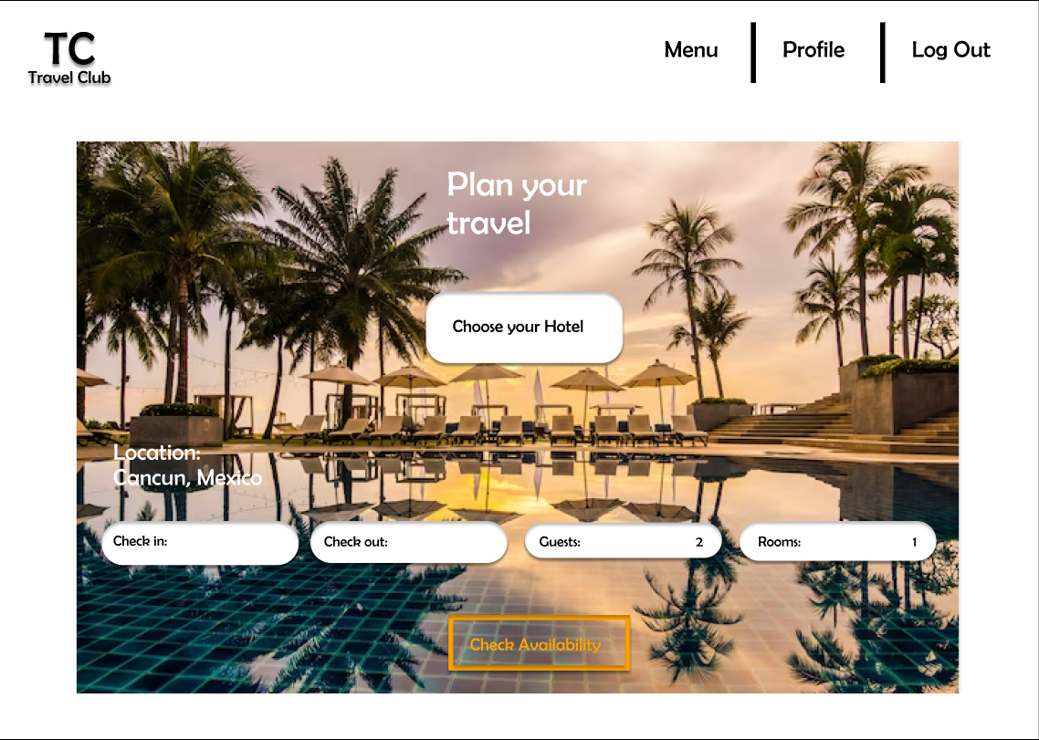
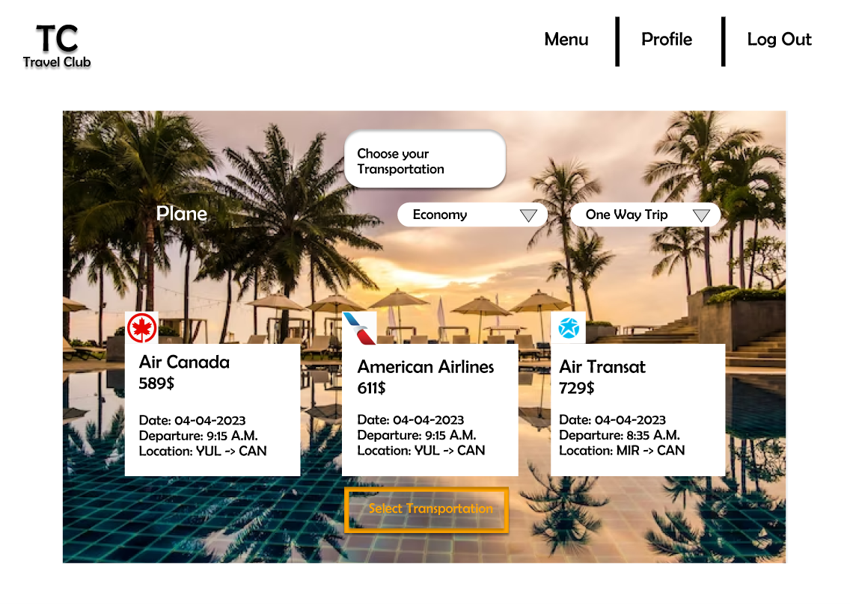
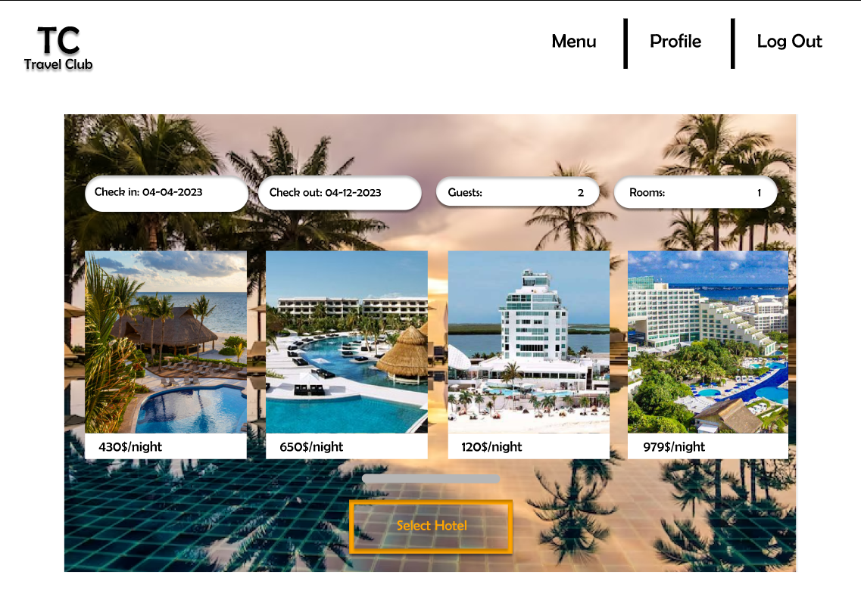
Reservation Section UI
List of offers for hotels
Greeting page of Reservation Section
List of offers for flights
Notes:
Jason

Slide 11
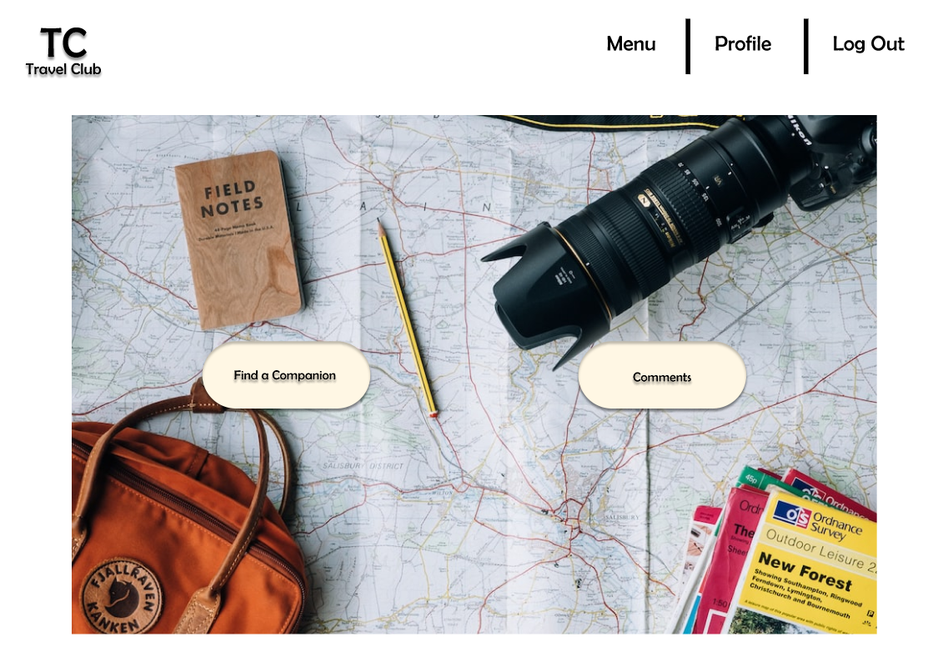
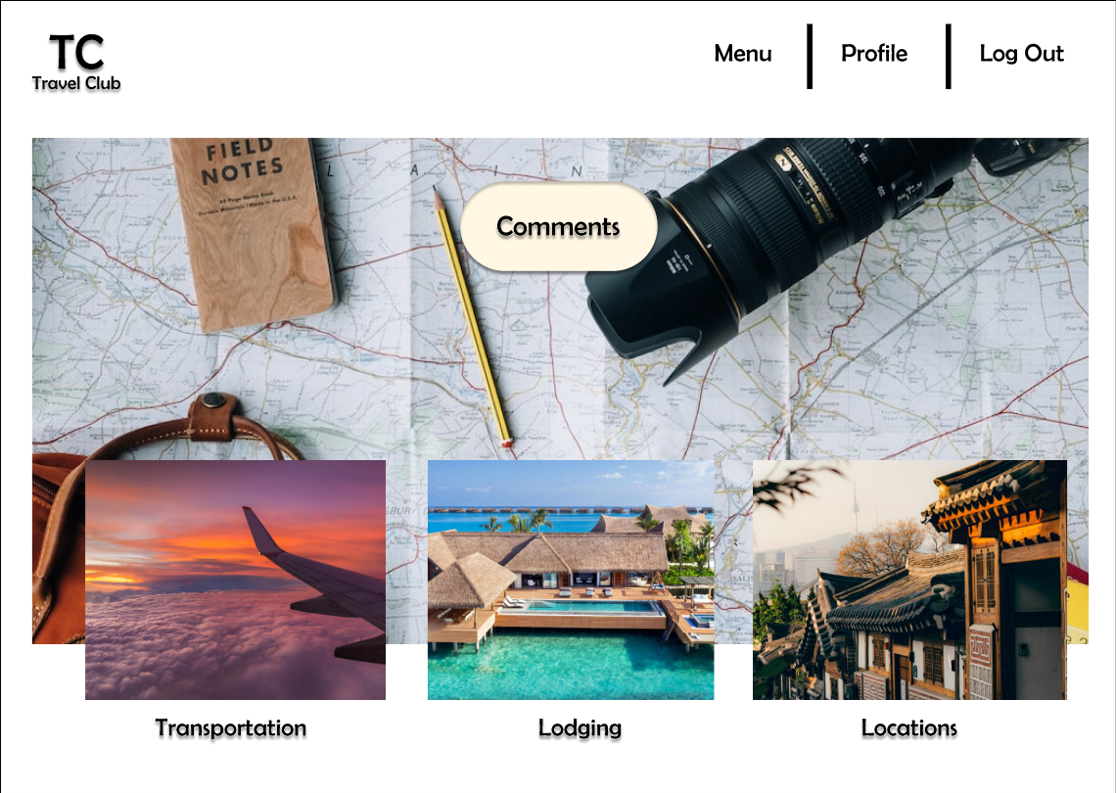
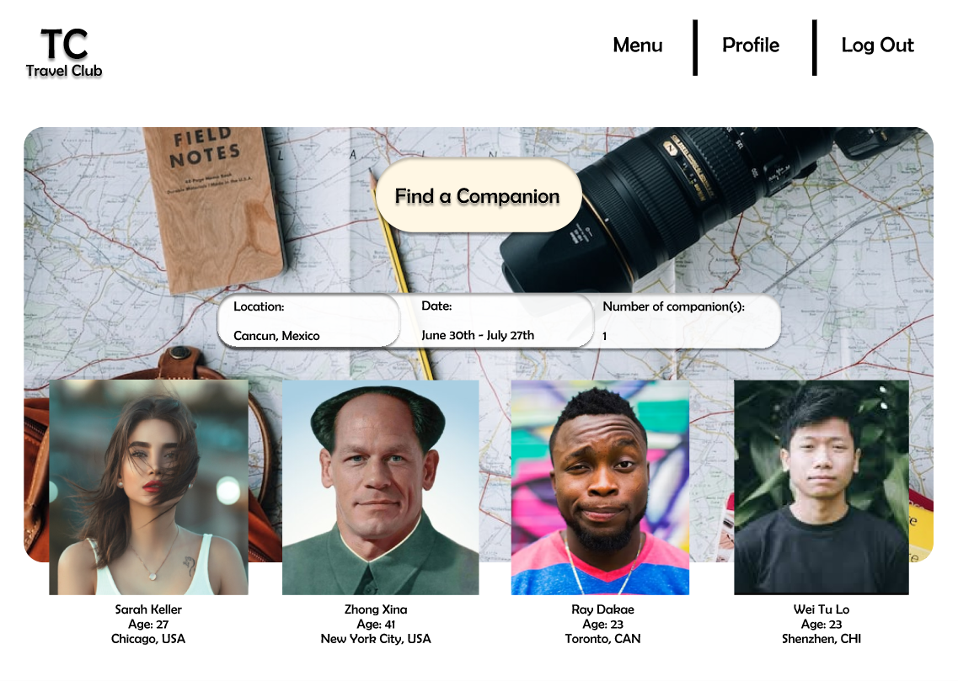
Social Network UI
Finding a travel companion.
Greeting page of social network section
Choosing on what to comment (transportation, lodging or location)
Notes:
Jason

Slide 12
Method Implementation
Four Methods:
createAndShowGUI()
Creates the submission form.
actionPerformed(ActionEvent e)
Performs the validation checks on the input information before submitting the application.
saveSubmissionsToFile()
Saves the application as a JSON object to an external file.
showMessageDialog()
Displays success or error message in a new window.
Notes:
Jonah

